Slide 1



2025
Benefits Open Enrollment
Presented by: Scott Benefit Services

Slide 2
Open Enrollment
Your annual opportunity to review and make changes to your benefits for the plan year that is effective October 1, 2025 through September 30, 2026
  Open enrollment: August 11 – 22
  PASSIVE, meaning that current benefits will carry over with the exception of HSA and FSA. You must (re)elect in your HSA/FSA contribution if you would like to continue contributing.
Making changes? Log into Proliant
Not making changes? Still log into Proliant to confirm benefits rolled over correctly and confirm personal information and beneficiaries
Please note, you cannot make changes to your benefits outside of open enrollment unless you experience a qualifying life event such as marriage, divorce, birth/adoption of child, change in employment status or loss of coverage

Slide 3

What’s Changing for 2025?
Medical
  Great news, no plan or cost changes!
  Anthem is moving to digital ID cards and EOBs – if you would like to receive physical copy, you’ll be able to request ID card and turn on paper EOBs within your member portal
  Sword Health now available to members and at no cost – access to virtual physical therapy
Dental
  Enhancement to High Plan maximum ($1,500)
  Less than $3 increase per pay period
HSA/FSA – 2025 contribution limits
No other changes to benefit package offered
Scan QR Code for digital Benefits Guide

Slide 4

Medical Plan
 | 25 / 500 / 20% / 4000 | HSA 3300 / 0% / 4500
In-Network Benefits
Embedded Deductible (Ind/Fam) | $500 / $1,000 | $3,300 / $6,600
Coinsurance | 20% | 0%
Out-of-Pocket Max. (Ind/Fam) | $4,000 / $8,000 | $4,500 / $9,000
Preventive Care | Covered 100% | Covered 100%
Vision Exam (Child/Adult) | $0 / $15 copay, 1 per year | $0 / $15 copay, 1 per year
Office Visits (PCP/Specialist) | $25 PCP / $50 SPC | Covered at 100% after deductible
Urgent Care | $50 copay | Covered at 100% after deductible
Emergency Room Services | 20% after deductible | Covered at 100% after deductible
Diagnostic Labs/X-rays | 20% after deductible | Covered at 100% after deductible
In/Outpatient Hospital Expenses | 20% after deductible | Covered at 100% after deductible
Mental Health & Substance Abuse | Inpatient: 20% after deductible; Outpatient: $25 | Covered at 100% after deductible
Prescription Drugs
Out-of-Pocket Max. | Combined with Medical | Combined with medical
Retail Pharmacy Copays | No deductible $10 / $40 / $70 / 20% up to $300 | Copays apply after deductible met $10 / $40 / $70 / 20% to $300
Mail Order Copays | $20 / $100 / $175 | $20 / $100 / $175
Out-of-Network Benefits
Deductible (Ind/Fam) | $1,000 / $2,000 | $6,600 / $13,200
Coinsurance | Anthem 70% / Employee 30% | Anthem 70% / Employee 30%
Out-of-Pocket Maximum (Ind/Fam) | $10,000 / $20,000 | $11,250 / $22,500
Employee Cost Per Pay Period
Employee Only | $67.20 | $0.00
Employee + Child | $229.65 | $72.19
Employee + Children | $535.74 | $259.40
Employee + Spouse | $633.34 | $330.56
Employee + Family | $1,023.15 | $618.31
Your spouse is only eligible to be enrolled on the health plan if they are not offered coverage by their employer. (annual Spousal Declaration Form)
  Need help comparing plans?
  Health Plan Assist helps you compare the plan offerings, estimating costs and premium responsibility and recommends HSA/FSA contribution amounts.
  Free tool!
  www.healthplanassist.com
  Access Code: VLH
Notes:
On this slide you will notice two medical plan offerings on the Anthem HK network. You have the 25/500 plan and the HSA 3300 plan to choose from. Both plans offer in and out of network coverage but utilizing in-network providers will allow for greater savings in your pocket. Both plans provide In-network Preventive services at no cost. In addition, a few other plan features is that they both cover vision exam only for Children up to age 19 at no cost and adults 19 and older as a $15 copay. So if you don’t need materials and just need the vision exam, you’ll be able to run this through your medical plan.
Both plans will also provide some Hearing Aid coverage for children under 19 years old as well (with one hearing aid per ear every 24 months up to a maximum of $1,500. Please note that Bone anchored hearing aids are not covered.)
When you are trying to determine which plan would be best for you or you and your family, you’ll want to consider the differences of these plan benefits and costs along with your expected health care utilization. You want to make sure you aren’t overinsured or underinsured. When I say over insured, that means buying up to the lower deductible plan which costs more, if you may not use your health benefits as frequently or have low costs services rendered throughout the year.
In exchange for a lower deductible, the 25/500 plan cost more out of your pocket per pay check. The HSA plan has a higher deductible but comes at a lower cost per paycheck.
The HSA plan is considered a High Deductible Health Plan in which services are subject to the deductible, meaning you pay the negotiated contract amount between your provider and Anthem until you’ve reached your deductible. Once your deductible is met, then medical services are covered at 100%. Prescriptions are also subject to the deductible but once the deductible is met, copays will kick in. Once you’ve reached out annual out of pocket costs, insurance will cover cost for prescriptions fully for the remaining plan year. On this HDHP, you’ll have HSA funds that you and VLH contribute to help offset the deductible costs.
The 25/500 plan works differently as it is considered a copay plan with a lower deductible. Certain services such as Office Visits for PCP and Specialist, Urgent Care, Therapy and mental health/substance abuse and prescriptions have a copays (which only apply towards the annual OOPM. Some services such as ER and inpatient hospital are subject to deductible then 20%. Meaning you pay the negotiated contract amount between your provider and Anthem until you’ve reached your deductible. Once your deductible is met, then you are responsible for 20% of the negotiated fee between Anthem and your provider. Once you’ve reached you OOPM, then services are covered at 100% for the remaining plan year.
Please note that deductibles and out of pocket maximums reset October 1.
If you need help comparing the plans, check out Health Plan Assist – which is a free tool. Not only do they help compare the plan benefits and costs, they also help provide recommendations on how much to set aside in a tax advantage account such as your health savings account or flexible spending account.
One final thing to note is that your spouse is only eligible to enroll in your health plan if they are not offered coverage through their employer – please make sure to complete the spousal affidavit form

Slide 5
Pharmacy Highlight
Mail order for maintenance medications
  Skip the pharmacy and have prescriptions delivered right to your doorstep
  Savings every 90 days
  Visit Anthem’s member portal or see your Benefit Guide for further details on how to get started
PreventiveRx Drug list
  Some preventive medications are covered at no cost to you if enrolled in the HSA 3300 / 0% / 4500 plan. (See PreventiveRx list here)
Generic Rx through EnsureRx will automatically compare some prescription costs and discounts for lowest cost option

Slide 6


Anthem Resources
Anthem’s Sydney app
  View/print/email or request physical ID card (Anthem will no longer be automatically mailing physical ID cards)
  View coverage and plan utilization
  View claims (Anthem will no longer be mailing paper EOBs unless you go into the portal and update your settings to receive paper copies)
  Access health related resources (Ex: Building Healthy Families)
  Compare costs of procedures through the Cost Comparison Tool
LiveHealth Online
  FREE access to a board-certified doctor who can diagnose and prescribe for non-emergency illness or concerns (see member portal/Sydney app or www.livehealthonline.com)

Slide 7


Anthem Programs
Employee Assistance Program (EAP)
  Provides you and your family members with up to 4 FREE confidential counseling sessions per issue per year to help cope with daily life challenges
  Additional referral services and resources available
  See Benefit Guide for contact information
Rula
  Virtual mental health support
  Select your therapist preferences with a broad provider network (gender, language, ethnicity and specialty)
  Book consistent future appointments in advance

Slide 8

Anthem Programs
Sword Health
  Virtual physical therapy with individualized educational support that provides real time feedback
  Members receive tablet and motion sensors to help guide members through exercises
  Available to Anthem members and at no cost – VLH’s covers the cost for you to have access to this program
  Commonly treated:
    Back
    Neck
    Elbow
    Ankle
    Shoulder
    Knee
    Wrist
    Hip
    Pelvic

Slide 9
Preventive Care Vs. Diagnostic Care
Preventive Care
Routine health care that includes screenings and checkups to help prevent and early detect illnesses, diseases and other health related problems.
  Well baby & child exams, adult physicals and wellness exams, immunizations, cancer screenings and more
In-network services covered 100% (no cost to you!)
Visit https://www.anthem.com/preventive-care for a list of covered services
Diagnostic Care
Additional screenings and services beyond preventive care that are given in response to symptoms or further testing
These services come at an additional cost (cost varies on service rendered and plan)
Check with your provider or Anthem to confirm costs associated with services rendered.
Notes:
As a reminder, all in-network preventive services are covered at no cost to you when enrolled in the medical plan. These services include but not limited to well baby exams, child exams, adult physicals, well women exams, immunizations and cancer screenings. You’ll want to visit Anthem.com for a list of preventive services.
By taking part in preventive care, you establish a base line with your doctor who can monitor and early detect something that could later be a much larger concern. Early detection may save you some money in the long run.
In addition, there are some medications that fall under preventive prescriptions, meaning that these medications are at no cost to you. Please see a list from HR.

Slide 10

Medicare Resource
If you or your spouse are Medicare eligible (65 years or older) – you have a free Medicare resource available to help you understand the complexity around Medicare options
Cheryl Murray at Scott Benefit Services can assist you today with:
  Understanding the different parts of Medicare (Parts A, B, C, and D)
  Evaluating Medicare Advantage vs. Original Medicare
  Reviewing prescription drug coverage options
  Coordinating employer-sponsored benefits with Medicare
  Estimating out-of-pocket costs and premiums
  Enrolling in Medicare and avoiding late penalties
Cheryl Murray
cmurray@scottins.com
804-441-6828

Slide 11
Flexible Spending Account (FSA)
Healthcare FSA –
  To pay for qualified out-of-pocket health care expenses (deductible, prescription copays, vision expenses and dental expenses) and much more
  2025 IRS Maximum Contribution limit: $3,300 individual or $6,600 joint couple per household with up to $660 rollover amount
  Full annual election amount available October 1
  Need help spending down your FSA? www.fsastore.com
Dependent Care FSA –
  To pay for qualified dependent care for eligible dependents under the age of 13 or for a spouse or relative who is physically or mentally incapable of self care that lives within your home
  2025 maximum contribution limit: $5,000 per household or $2,500 if married filing separately
  Funds available as you contribute into it

Slide 12
Health Savings Account (HSA)
Health Savings Account (HSA)
Save and pay for qualified medical, pharmacy, dental and vision expenses
You and VLH can contribute pre-taxed dollars
Funds are available as you contribute and accumulate/roll over year to year
Portable
You can make changes to your contribution throughout the year (but not to exceed the IRS maximum limits)
Eligibility requirements:
  Must be enrolled in the HSA medical plan to be eligible to open a Health Savings Account (HSA)
  Not be enrolled covered in by another health insurance (includes Medicare and Tricare)
  Not be claimed as a dependent on someone else’s tax return
  Cannot have a full medical FSA, including your spouse
  Cannot have been treated by a VA Medical Center for a non-service-related condition in the past 90 days

Slide 13
HSA Contribution Limits
IRS annual maximum contribution limits:
  2025: $4,300 (individual) and $8,550 (family)
  2026: $4,400 (individual) and $8,750 (family)
  If you are age 55 or older, you may make an additional “catch-up” contribution of $1,000
Employer contribution (Up to $1,000):
  VLH will make a one-time contribution of $250 towards your HSA if you begin contributing on your first payroll deduction
  In addition, VLH will match dollar for dollar up to $750
The combined contribution from the employer and employee cannot exceed the annual maximum set by the IRS

Slide 14
HSA Expenses
Qualified Expenses | Non-Qualified Expenses
Deductible & Coinsurance Dr. Office & Specialist Chiropractor / Acupuncture Prescription Drugs Hospital Stays Radiology Lab Work Speech / Occupational / Physical Therapy Vision Check ups Eyeglasses & Contacts Dental work Orthodontia Over-the-Counter Medications Menstrual Products | Cosmetic Surgery Medicine from other countries Nutritional Supplements Teeth Whitening Veterinary Fees Weight-Loss Program Health Club Dues Child Care or Nursing Services Please note there is a 20% tax penalty for non-qualified medical expenses withdrawn prior to age 65

Slide 15
KnovaSolutions
Do you have complex healthcare needs? KnovaSolutions dedicated team consists of a master’s level education nurse, health educator and pharmacist clinician team that help you navigate your healthcare questions and concerns.
  Provide you with information, education, and decision support tools so that you can take control over your health
Proactive outreach – if they see you/your dependents have complex healthcare and benefit utilization such as having multiple illnesses, seeing multiple providers or taking multiple medications
  Call comes from Cheyenne, Wyoming then followed by a mailed letter
Available to employees and their dependents (18 years or older) enrolled on the health plan
No cost
100% confidential

Slide 16

Twin Health - Metabolic
LOSE WEIGHT & HEAL YOUR METABOLISM
LOWER RISK FOR PRE-DIABETES
OVERCOME TYPE 2 DIABETES
– MEET TWIN HEALTH
Lifechanging program that helps you reduce your medication, heal your disrupted metabolism and for participants with Type 2 Diabetes, reverse it!
Uses sensors to see how you respond to food, activity and sleep – giving you real-time personalized support
Available to you and your dependents age 18+ enrolled on health plan

Slide 17
Delta Dental Plan
 | Low Plan | High Plan
In Network Benefits
Annual Deductible | Single: $50 | Family: $150 | Single: $50 | Family: $150
Annual Maximum | $750 | $1,500
Preventative Services: Exams, Cleanings, X-rays | Covered at 100% | Covered at 100%
Basic Services: Fillings, Stainless Steel Crowns, Simple Extraction, Oral Surgery, Periodontics, Endodontics, Denture Repair | 80% | 80%
Major Services: Crowns, Prosthodontics, Implants | Not Covered | 50%
Orthodontics (Children under 26) | Not Covered | 50% up to $1,000 lifetime maximum
Out of Network Benefits
Preventative / Basic / Major | 100% / 80% / Not-Covered | 100% / 80% / 50%
Max Over: If you receive at least one preventive cleaning and use less than half of the annual maximum, a portion of your unused annual maximum will automatically be rolled over to the next plan year.
Deductibles and maximums reset 10/1
In-network: PPO & Premier
Employee cost per pay period
 | Low Plan | High Plan
Employee Only | $6.60 | $12.80
Employee + Child(ren) | $18.24 | $31.26
Employee + Spouse | $17.19 | $29.57
Employee + Family | $24.08 | $40.06

Slide 18
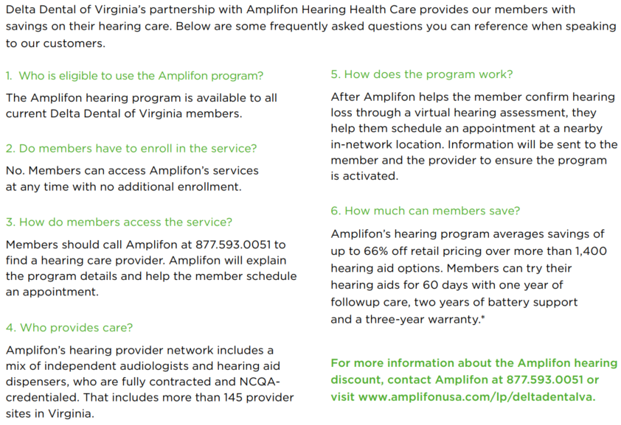
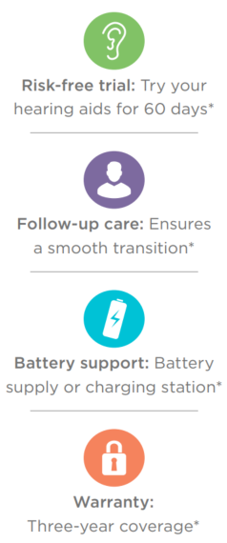
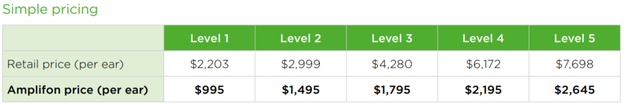
Delta’s Hearing Program

Slide 19
EyeMed Vision Plan
 | In-Network | Out-of-Network (reimbursement)
Routine Eye Exam | $15 Copay (once every 12 months) | Up to $30
Standard Plastic Lenses (Single, Bifocal, Trifocal & Lenticular) | $25 Copay (once every 12 months) | Single up to $25 Bifocal up to $40 Trifocal up to $60
Progressives | Standard Lens: $90 Premium Progressive Lens: Tier 1 - $110 | Tier 2 - $120 Tier 3 - $135 | Tier 4 - $90, 80% of charge less $120 allowance | Up to $40
Contact Lenses Conventional Disposable Medically Necessary | $0 copay | $130 allowance 15% off balance over $130 Responsible for balance over $130 $0 copay, paid in full | Up to $104 Up to $104 Up to $210
Frame (once every 12 months) | $0 copay, $130 Allowance, 20% off balance over $130 | Up to $65
Lasik | 15% off retail price or 5% off promotional price | N/A
Employee cost per pay period
Employee Only | $0
Employee + Child(ren) | $2.57
Employee + Spouse | $2.32
Employee + Family | $4.99

Slide 20
Life Insurance
Basic Term Life Insurance (Employer Paid)
Employee | Up to 2x your annual earnings up to $300,000 (not subject to Evidence of Insurability)
Voluntary Life Insurance (Employee Paid)
Employee | Up to 5x your annual earnings in $5,000 increments up to $250,000 (minimum of $10,000) Guaranteed Issue: Lesser than 5x your annual earnings up to $200,000
Spouse | Minimum of $5,000 up to a maximum of $50,000 Guaranteed Issue: $25,000 You must elect employee voluntary life in order to have coverage on your spouse
Children | $10,000 Guaranteed as long as Employee Voluntary Life is approved You must elect employee voluntary life in order to have coverage on your child(ren) Dependent children can be covered from 15 days old to 26 years old.
Voluntary Life Evidence of Insurability (EOI) Requirements
New hires electing over the guaranteed issue must submit EOI
Late entrants/existing employees enrolling or increasing amount must submit EOI for any amount of coverage even if under the guaranteed issue amount
Don’t forget to update your beneficiaries

Slide 21
Hartford Disability Insurance
In the event you become disabled from a non-work-related injury or illness, disability income benefits are provided as a source of income
  Hourly (non-exempt) employees have the option to purchase Short-Term Disability and Long-Term Disability Insurance through employee payroll deductions
  Full-time exempt employees are provided employer paid Long-Term Disability Insurance and have the option to purchase Voluntary Short-Term Disability Insurance through payroll deductions
Voluntary Disability Evidence of Insurability:
  Previously waived coverage when first offered (late entrant) must submit EOI
 | Benefit Amount | Benefits Begin | Maximum Benefit Period
Short-term 15 DAY PLAN | 60% of your income up to a maximum of $500 per week | 15 days after injury or illness | 24 weeks
Short-Term Option 30 DAY PLAN | 60% of your income up to a maximum of $500 per week | 30 days after injury or illness | 22 weeks
Long-Term | 60% of your income up to a maximum of $5,000 per month | 180 days, integrated from short-term disability | If you become disabled prior to age 63, benefits are payable to normal retirement age or 42 months if greater. 63 (or older), the benefit period will be based on a reduced duration schedule.

Slide 22
Hartford Voluntary Worksite Coverages
    Benefits are paid in a lump-sum benefit upon diagnosis that can be used however you choose from expenses related to treatment, deductibles or day-to-day costs of living such as mortgage or utility bills
Accident
  Injury, medical treatment and/or services occur that result from a covered accident
  Payout examples: $200 for Emergency Room; Up to $6,000 for dislocation; $250 for Urgent Care
  Critical Illness
    Serious illness (Cancer, Vascular and Neurological) - $5k - $20k options available
  Hospital Indemnity
    Confined in a hospital for a covered illness or injury
    Payout Examples: $500 for first day confinement and $100 for future days up 30 days; $200 for ICU up to 10 days
See Proliant for rates

Slide 23
Hartford Value Added Benefits
ABILITY ASSIST COUNSELING SERVICES
Provides access to Master’s degree clinicians for 24/7 assistance. This includes 3 face-to-face visits per occurrence per year for emotional concerns and unlimited phone consultations for financial, legal and work-life concerns.
BENEFICIARY ASSIST COUNSELING SERVICES
Compassionate expertise to help you, your beneficiaries and immediate family members cope with emotional, financial and legal issues that arise after a loss. Includes unlimited phone contact with professionals as well as five face-to-face sessions for up to one year.
ESTATE GUIDANCE WILL SERVICES
Helps Protect your family’s future by creating a customized and legally binding online will. Online support is also available from licenses attorneys, if needed.
HEALTH CHAMPION
Offers unlimited access to benefit specialist and nurses for administrative and clinical support to address medical care and insurance claims concerns if you’re enrolled in our life plan. Services include claims and billing support, explanation of benefits, cost estimates and fee negotiation, information related to conditions and available treatments and support to help prepare fore medical visits.
FUNERAL CONCIERGE SERVICES
Provides a suite of online tools to guide you through key decisions before a loss, including help comparing funeral-related costs. After a loss, this service includes family advocacy and professional negotiation of funeral prices with local providers often resulting in significant financial savings. In addition, Express Pay is a service that delivers proceeds in as little as 48 hours, allowing beneficiaries to use proceeds immediately for funeral expenses.

Slide 24
Reminder
Open enrollment ends August 22
Log into Proliant to ensure benefits rolled over or to make changes
To continue contributing to HSA or FSA, please select contribution amount (current election amount will not roll over)

Slide 25
This is not a contract or policy. This outline of coverage is only a summary of benefits. If there are any differences between this presentation and the group policies, the provisions in the group policies will govern.
Always refer to the carrier documents for additional limitations & exclusions.

