Slide 1


2024 Benefits Open Enrollment
Benefits Effective: October 1, 2024 through September 30, 2025
Presented by: Scott Benefit Services

Slide 2
Open Enrollment
Your annual opportunity to review and make changes to your benefits for the plan year that is effective October 1, 2024 through September 30, 2025
  Open enrollment: August 12 – 23
  PASSIVE, meaning that current benefits will carry over with the exception of HSA and FSA. You must (re)elect in your HSA/FSA contribution if you would like to continue contributing.
Making changes? Log into Proliant
Not making changes? Still log into Proliant to confirm benefits rolled over correctly and confirm personal information beneficiaries
Don’t forget to submit annual Spousal Affidavit if enrolling your spouse in medical coverage (spouse only eligible if their employer doesn’t offer health coverage)
Please note, you cannot make changes to your benefits outside of open enrollment unless you experience a qualifying life event such as marriage, divorce, birth/adoption of child, change in employment status and loss of coverage

Slide 3
What’s Changing
Good news! Minimal changes. No changes to carriers, plans or costs with the exception of the below:
Medical
  Slight increase to the HSA medical plan to meet IRS guidelines (but no cost change!)
  Enhancement on health plan pharmacy and hearing aid coverage
  Reminder: Spouses are only eligible on the health plan if they are not offered coverage by their employer. You must submit annual Spousal Declaration Form for upcoming plan year.
HSA/FSA
  IRS increased the maximum contribution limit

Slide 4
Medical Plan
 | POS 25 / 500 / 20% / 4000 | HSA 3300 / 0% / 4500
In-Network Benefits
Embedded Deductible (Ind/Fam) | $500 / $1,000 | $3,300 / $6,600
Coinsurance | 20% | 0%
Out-of-Pocket Max. (Ind/Fam) | $4,000 / $8,000 | $4,500 / $9,000
Preventive Care | Covered 100% | Covered 100%
Vision Exam (Child/Adult) | $0 / $15 copay, 1 per year | $0 / $15 copay, 1 per year
Office Visits (PCP/Specialist) | $25 PCP / $50 SPC | Covered at 100% after deductible
Urgent Care | $50 copay | Covered at 100% after deductible
Emergency Room Services | 20% after deductible | Covered at 100% after deductible
Diagnostic Labs/X-rays | 20% after deductible | Covered at 100% after deductible
In/Outpatient Hospital Expenses | 20% after deductible | Covered at 100% after deductible
Mental Health & Substance Abuse | Inpatient: 20% after deductible; Outpatient: $25
Prescription Drugs
Out-of-Pocket Max. | Combined with Medical | Combined with medical
Retail Pharmacy Copays | No deductible $10 / $40 / $70 / 20% up to $300 | Copays apply after deductible met $10 / $40 / $70 / 20% to $300
Mail Order Copays | $20 / $100 / $175 | $20 / $100 / $175
Out-of-Network Benefits
Deductible (Ind/Fam) | $1,000 / $2,000 | $6,600 / $13,200
Coinsurance | Anthem 70% / Employee 30% | Anthem 70% / Employee 30%
Out-of-Pocket Maximum (Ind/Fam) | $10,000 / $20,000 | $11,250 / $22,500
Employee Cost Per Pay Period
Employee Only | $67.20 | $0.00
Employee + Child | $229.65 | $72.19
Employee + Children | $535.74 | $259.40
Employee + Spouse | $633.34 | $330.56
Employee + Family | $1,023.15 | $618.31
Changes/Enhancements:
HSA deductible increase from $3,000/$6,000 to $3,300/$6,600
Generic mail order copay $25 to $20
Hearing Aids will be covered for children under 19 years old. One per hearing-impaired ear every 24 months up to a maximum of $1,500 (Bone anchored hearing aids not covered)
  Need help comparing plans?
  Health Plan Assist helps you compare the plan offerings, estimating costs and premium responsibility and recommends HSA/FSA contribution amounts.
  Free tool!
  www.healthplanassist.com
  Access Code: VLH
Notes:
On this slide you will notice two medical plan offerings (which include their in-network benefits, prescription coverage and out-of-network benefits). Both plans are on the Anthem Healthkeepers Network, which is a Virginia based network.. You have two medical options to choose from: the HSA plan or the POS plan.
When you are trying to determine which plan would be best for you or you and your family, you’ll want to consider your expected health care utilization – How often do you visit your doctor and for what? Do you have any upcoming expected surgeries or procedures? Are you taking part in the in-network preventive care services which are at no cost? These are some things you’ll want to think about.
Now let’s discuss the plans a little further:
The HSA plan is considered a High Deductible Health Plan. This essentially means you have a higher deductible to reach, but your premiums will be lower. Services will be subject tto the deductible (which is $3300 for individual and $6,600 for family), meaning you continue paying negotiate contracted amount between your provider and Anthem until you’ve reached your deductible. Once your deductible is met, then you will be responsible for the 20% coinsurance until you reach your annual out-of-pocket-maximum (which is $4500 for individual and $9k for family). Prescriptions are also subject to the deductible but once the deductible is met, copays will kick in. Once annual out of pocket maximum is met, insurance will cover costs.
Keep in mind with you’ll have the HSA funds which are tax free dollars to help pay for eligible services or items, to help offset the deductible amount. We’ll discuss HSA details on a future slide.
The POS plan works differently as it is considered a copay plan with a lower deductible ( $500k for individual and $1,k for family) than the HSA plan but this plan will cost more per pay check. The where a copay would apply for certain services such as Office Visits for PCP and Specialist, Urgent Care, Therapy and mental health/substance abuse and prescriptions as mentioned above. There is no deductible to meet, as the copays automatically kick in. Some services such as ER and inpatient hospital are subject to deductible then 20%.
Both plans include one adult vision exam per plan year a $15 copay, and preventive services at no cost. There is also in network and out of network benefits but by utilizing in-network providers, you will experience less out of pocket costs.
Deductibles and out of pocket maximums are annual meaning they reset June 1.

Slide 5
Pharmacy Highlight
Mail order for maintenance medications
  Skip the pharmacy and have prescriptions delivered right to your doorstep
  Savings every 90 days (cost caries on tier)
  Visit Anthem’s member portal or see your Benefit Guide for further details on how to get started
PreventiveRx Drug list
  Some preventive medications are covered at no cost to you if enrolled in the HSA 3300 / 0% / 4500 plan. See PreventiveRx list here)
New! Generic Rx through EnsureRx will automatically compare costs and discounts for lowest cost prescription
  Discount cards no longer needed and costs count towards your deductible (unlike with discount cards)

Slide 6



Anthem Medical Resources
Anthem’s Sydney app
  View/print ID card
  View coverage, claims, deductible utilization and OOPM utilization
  Access health related resources (Ex: Building Healthy Families)
  Compare costs of procedures through the Cost Comparison Tool
LiveHealth Online
  FREE access to a board-certified doctor who can diagnose and prescribe for no- emergency illness or concerns (see member portal/Sydney app or www.livehealthonline.com)
Employee Assistance Program (EAP)
  Provides you and your family members with up to 4 FREE confidential counseling sessions per issue per year and referral services to help cope with daily life challenges
  Additional referral services and resources available
  See Benefit Guide for contact information

Slide 7
Preventive Care Vs. Diagnostic Care
Preventive Care
Routine health care that includes screenings and checkups to help prevent and early detect illnesses, diseases and other health related problems.
  Well baby & child exams, adult physicals and wellness exams, immunizations, cancer screenings and more
In-network services covered 100% (no cost to you!)
Visit https://www.anthem.com/preventive-care for a list of covered services
Diagnostic Care
Additional screenings and services beyond preventive care that are given in response to symptoms or further testing
These services come at an additional cost (cost varies on service rendered and plan)
Check with your provider or Anthem to confirm costs associated with services rendered.
Notes:
As a reminder, all in-network preventive services are covered at no cost to you when enrolled in the medical plan. These services include but not limited to well baby exams, child exams, adult physicals, well women exams, immunizations and cancer screenings. You’ll want to visit Anthem.com for a list of preventive services.
By taking part in preventive care, you establish a base line with your doctor who can monitor and early detect something that could later be a much larger concern. Early detection may save you some money in the long run.
In addition, there are some medications that fall under preventive prescriptions, meaning that these medications are at no cost to you. Please see a list from HR.

Slide 8
When You Need Care
LiveHealth
Online
Cost: $0
Average wait: 10 mins or less
Ex: For non-emergency related illness or concerns
Cost: $
Average wait: 18 mins or less
Ex: Asthma, back pain, flu symptoms, eye or sinus infection, sore throat, UTI, earaches, minor cuts and scrapes and non-emergency related illnesses or concerns
PCP
Retail
Health
Clinic
Cost: $$
Average wait: 30 mins
Ex: Ensure tests, sore throats, earaches, bumps, minor cuts and scrapes, UTI and more
Urgent
Care
Cost: $$$
Average wait: 30 mins
Ex: Ensure tests, sore throats, earaches, bumps, minor cuts and scrapes, UTI and more
Cost: $$$$
Average wait: 30 mins
Ex: Serious illnesses or concerns such but not limited to heart attack (chest pain), stroke (numbness or slurred speech), difficulty breathing, severe burn or bleed and much more
Emergency
Room

Slide 9
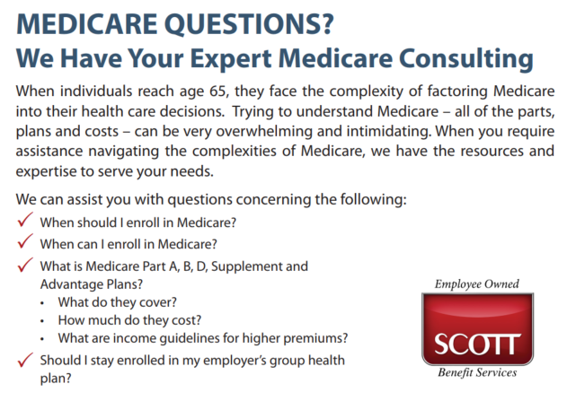

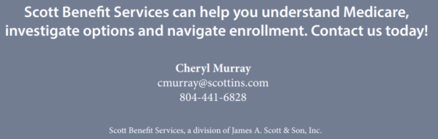
Medicare Resource

Slide 10
Flexible Spending Account (FSA)
Heathcare FSA – spending account where you set a side pre-taxed dollars to pay for qualified out-of-pocket health care expenses such as portion of your deductible, prescription copays, vision expenses and dental expenses.
  2024 IRS Maximum Contribution limit: $3,200 individual or $6,400 joint couple per household
  Use It or Lose It (up to $640 of unused FSA dollars carries over to the 2025/26 plan year)
  Full fund available October 1
  Need help spending down your FSA? www.fsastore.com
Dependent Care FSA – spending account where you contribute pre-tax dollars to qualified dependent care.
  2024 maximum contribution limit: $5,000 per household or $2,500 if married filing separately
  Eligible dependents under the age of 13 or your spouse or relative who is physically or mentally incapable of self-care and lives in your home.
  Fund available as you contribute into it
You must re-elect FSA contribution every year if you want to continue contributing

Slide 11
Health Savings Account (HSA)
Health Savings Account (HSA) is a tax-advantage account to help you save and pay for qualified medical, pharmacy, dental and vision expenses
Contributions are taken directly from your paycheck, before taxes, and placed into the account (tax savings)
Funds are available as you contribute and accumulate/roll over year to year
Portable
Eligibility requirements:
  Must be enrolled in the HSA medical plan to be eligible to open a Health Savings Account (HSA)
  Not be enrolled covered in by another health insurance (includes Medicare and Tricare)
  Not be claimed as a dependent on someone else’s tax return
  Cannot have a full medical FSA, including your spouse
  Cannot have been treated by a VA Medical Center for a non-service-related condition in the past 90 days

Slide 12
HSA Contribution Limits
IRS annual maximum contribution limits:
  2024: $4,150 (individual) and $8,300 (family)
  2025: $4,300 (individual) and $8,550 (family)
  If you are age 55 or older, you may make an additional ”catch-up” contribution of $1,000.
VLH’s will make a one-time contribution of $250 towards your HSA if you begin contributing on your first payroll deduction; in addition to the $250, VLH will match dollar for dollar up to $750 (VLH total annual contribution: $1,000)
The combined contribution from the employer and employee cannot exceed the annual maximum set by the IRS (shown below)
DON’T FORGET: You must re-elect HSA contribution every year (funds roll over but your election doesn’t

Slide 13
HSA Eligible Expenses
Qualified Expenses | Non-Qualified Expenses
Deductible & Coinsurance Dr. Office & Specialist Chiropractor / Acupuncture Prescription Drugs Hospital Stays Radiology Lab Work Speech / Occupational / Physical Therapy Vision Check ups Eyeglasses & Contacts Dental work Orthodontia Over-the-Counter Medications Menstrual Products | Cosmetic Surgery Medicine from other countries Nutritional Supplements Teeth Whitening Veterinary Fees Weight-Loss Program Health Club Dues Child Care or Nursing Services Please note there is a 20% tax penalty for non-qualified medical expenses withdrawn prior to age 65

Slide 14
KnovaSolutions
KnovaSolutions helps you navigate complex healthcare needs
Proactive outreach – KnovaSolutions reaches out to you if they see that you/your dependents have complex healthcare and benefit utilization
  Ex of complex healthcare/utilization: multiple illnesses, providers, medications, work, life and health issues
  Call comes from Cheyenne, Wyoming then followed by a mailed letter
Dedicated support team consists of master’s level educated nurse, health educator and pharmacist clinician team who help provide you with information, education, and decision support tools so that you can take control over your health
No cost & 100% confidential

Slide 15
Diabetes Resources
If enrolled in the health plan, you have FREE diabetes resources available!
Are you pre-diabetic or at risk? Check out Lark!
  Pre-diabetes engagement program where you’ll receive a personalized 26-week digital health coaching solution that leverages artificial intelligence, cognitive behavioral therapy and smart connected devices
  Helps lower risk of developing Type 2 Diabetes (Pre-Diabetes)
  Focus areas are weight loss, physical activity, nutritional counseling, stress management and sleep
Diagnosed with Type 2 Diabetes? Check out TwinHealth!
  Life changing program that helps you reduce medication use, heal your disrupted metabolism and reverse Type 2 Diabetes
  Whole Body Digital TwinTM — a digital representation of your metabolic health using sensors to see how you respond to food, activity, and sleep
  Gives real-time, personalized recommendations via the Twin app. and dedicated care team
  Available to you and your dependents age 18 years or older
  Details on how to learn more or see if eligible, please see Benefit Guide.

Slide 16
Delta Dental Plan
 | Low Plan | High Plan
In Network Benefits
Annual Deductible | Single: $50 | Family: $150 | Single: $50 | Family: $150
Annual Maximum | $750 | $1,250
Preventative Services: Exams, Cleanings, X-rays | Covered at 100% | Covered at 100%
Basic Services: Fillings, Stainless Steel Crowns, Simple Extraction, Oral Surgery, Periodontics, Endodontics, Denture Repair | 80% | 80%
Major Services: Crowns, Prosthodontics, Implants | Not Covered | 50%
Orthodontics (Children under 26) | Not Covered | 50% up to $1,000 lifetime maximum
Out of Network Benefits
Preventative / Basic / Major | 100% / 80% / Not-Covered | 100% / 80% / 50%
Max Over: If you receive at least one preventive cleaning and use less than half of the annual maximum, a portion of your unused annual maximum will automatically be rolled over to the next plan year.
Employee cost per pay period
 | Low Plan | High Plan
Employee Only | $5.82 | $11.61
Employee + Child(ren) | $16.70 | $28.87
Employee + Spouse | $15.72 | $27.29
Employee + Family | $22.16 | $37.09
Deductibles and maximums reset 10/1
In-network: PPO & Premier

Slide 17
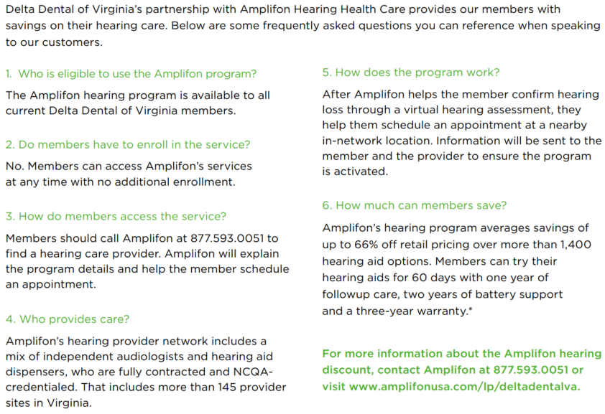
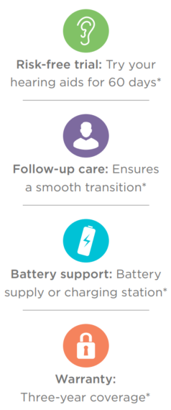
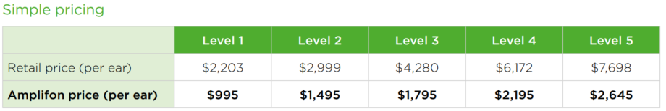
Delta’s Hearing Program

Slide 18
EyeMed Vision Plan
 | In-Network | Out-of-Network (reimbursement)
Routine Eye Exam | $15 Copay (once every 12 months) | Up to $30
Standard Plastic Lenses (Single, Bifocal, Trifocal & Lenticular) | $25 Copay (once every 12 months) | Single up to $25 Bifocal up to $40 Trifocal up to $60
Progressives | Standard Lens: $90 Premium Progressive Lens: Tier 1 - $110 | Tier 2 - $120 Tier 3 - $135 | Tier 4 - $90, 80% of charge less $120 allowance | Up to $40
Contact Lenses Conventional Disposable Medically Necessary | $0 copay | $130 allowance 15% off balance over $130 Responsible for balance over $130 $0 copay, paid in full | Up to $104 Up to $104 Up to $210
Frame (once every 12 months) | $0 copay, $130 Allowance, 20% off balance over $130 | Up to $65
Lasik | 15% off retail price or 5% off promotional price | N/A
Employee cost per pay period
Employee Only | $0
Employee + Child(ren) | $2.57
Employee + Spouse | $2.32
Employee + Family | $4.99

Slide 19
Hartford Disability Insurance
Basic Term Life Insurance (Employer Paid)
Employee | Up to 2x your annual earnings up to $300,000 (not subject to Evidence of Insurability)
Voluntary Life Insurance (Employee Paid)
Employee | Up to 5x your annual earnings in $5,000 increments up to $250,000 (minimum of $10,000) Guaranteed Issue: Lesser than 5x your annual earnings up to $200,000
Spouse | Minimum of $5,000 up to a maximum of $50,000 Guaranteed Issue: $25,000 You must elect employee voluntary life in order to have coverage on your spouse
Children | $10,000 Guaranteed as long as Employee Voluntary Life is approved You must elect employee voluntary life in order to have coverage on your child(ren) Dependent children can be covered from 15 days old to 26 years old.
Evidence of Insurability (EOI) Requirements
New hires electing over the guaranteed issue must submit EOI
Late entrants/existing employees enrolling or increasing amount must submit EOI for any amount of coverage even if under the guaranteed issue amount
Don’t forget to update your beneficiaries

Slide 20
Hartford Disability Insurance
In the event you become disabled from a non-work-related injury or illness, disability income benefits are provided as a source of income
Hourly (non-exempt) employees have the option to purchase Voluntary Short-Term Disability and Long-Term Disability Insurance through employee payroll deductions
Full-time exempt employees are provided employer paid Long-Term Disability Insurance and have the option to purchase Voluntary Short-Term Disability Insurance through payroll deductions
New hires can elect in this coverage without submitting an Evidence of Insurability (EOI) form. If you’ve previously waived coverage when first offered (late entrant), you are required to submit an EOI form (subject to approval).
 | Benefit Amount | Benefits Begin | Maximum Benefit Period
Voluntary Short-term 15 DAY PLAN | 60% of your income up to a maximum of $500 per week | 15 days after injury or illness | 24 weeks
Voluntary Short-Term Option 30 DAY PLAN | 60% of your income up to a maximum of $500 per week | 30 days after injury or illness | 22 weeks
Long-Term | 60% of your income up to a maximum of $5,000 per month | 180 days, integrated from short-term disability | If you become disabled prior to age 63, benefits are payable to normal retirement age or 42 months if greater. 63 (or older), the benefit period will be based on a reduced duration schedule.

Slide 21
Hartford Voluntary Worksite Coverages
Accident
  Provides you coverage when injury, medical treatment and/or services occur that result from a covered accident
  You’ll receive payments associated with a covered injury and related service
  You can use the payment in any way you choose, from expenses not covered by your major medical plan to day-to-day costs of living such as mortgage or utility bills
  Critical Illness
    Provides coverage for serious illness
    Benefits are paid in a lump-sum benefit upon diagnosis that can be used however you choose from expenses related to treatment, deductibles or day-to-day costs of living such as mortgage or utility bills
  Hospital Indemnity
    Cash benefit for you or an insured dependent (spouse/child) who are confined in a hospital for a covered illness or injury
    Benefits are paid in lump sum amounts to you and can help offset expenses that may not be covered under your primary health insurance (deductibles, co-insurance amounts or copays) or benefits can be used for any non-medical expenses (like housing costs, groceries, car expenses, etc.)

Slide 22
This is not a contract or policy. This outline of coverage is only a summary of benefits. If there are any differences between this presentation and the group policies, the provisions in the group policies will govern.
Always refer to the carrier documents for additional limitations & exclusions.

